Slide 1
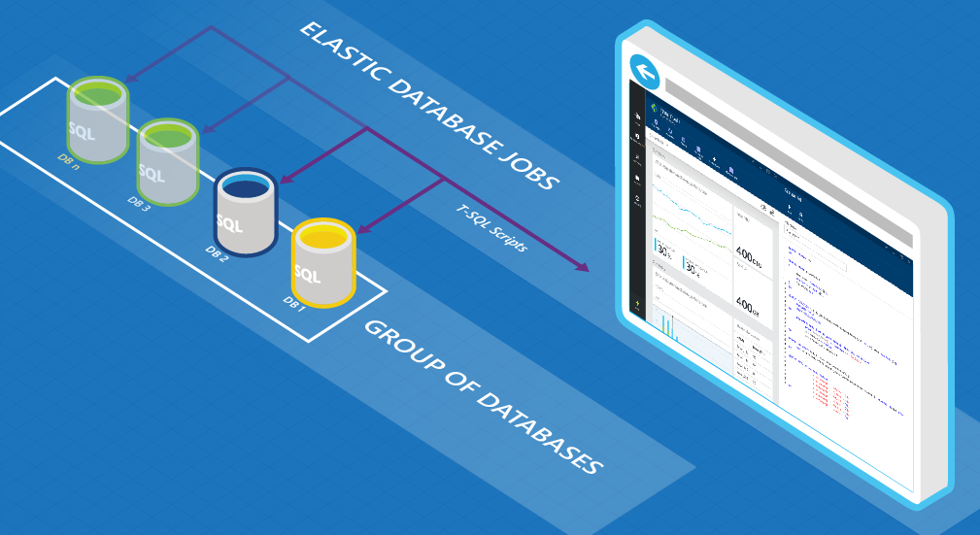

SQL Agent in the Cloud

Slide 2






Sam Cogan
Solution Architect – Willis Towers Watson
Microsoft Azure MVP
samcogan.com
@samcogan
sam-cogan

Slide 3
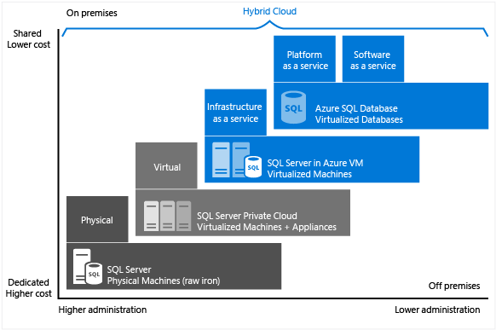

Slide 4






SQL Agent Alternatves
SQL Agent is not present in Azure SQL
Azure SQL Elastics Jobs
Azure Automation
SQL IaaS
Azure SQL
Managed Instance
Azure Functions
Azure Data Factory

Slide 5






Elastic Database Jobs
Write Jobs in T-SQL
Run jobs across databases in parallel
Supports Azure SQL Databases, Servers and Elastic Pools
One-Off or scheduled jobs
Currently in preview (still)
$10-$3000 per month – Depends on job database size

Slide 6
Elastic Database Jobs

Slide 7






Azure Automation
PowerShell & Python 2
On-demand, schedule or web hook
Secure variable storage
3 hour execution window (with resume)
Supports Hybrid Workers
500 Minutes Free, then $0.002 per minute

Slide 8





Azure Functions
Serverless, Event based compute
Multiple Languages, some in preview
Multiple triggers & bindings
Nearly instant start-up
Autoscaling and dynamic memory
5 minute execution window
Large free grant, then per GB per execution

Slide 9
Compare and Contrast
 | Elastic Jobs | Automation | Functions
Languages | T-SQL | PowerShell | Multiple Languages
Job Length | Long Running Jobs | Long Running Jobs | Short Jobs
Triggers | Manual or Time Trigger | Manual, Webhook or Timer Trigger | Many Triggers
Input & Output | DB Input & Output | Manual Input & Output | Many Input & Output Bindings
Targets | Multiple concurrent targets | Build your own concurrency | Build your own concurrency
Startup | Fast start | Delayed Start | Instant Start
Resource Access | Azure SQL Only | Hybrid Workers | Web app options
Scale | Scale on Job DB size | No scaling | Dynamic scaling
Cost | Database SKU | Per Job (free grant) | Per second & memory (free grant)

Slide 10
Advanced Functionality
Move Beyond Maintenance
Scaling
Backup/Export
Provisioning
Integration
Event Grid
Azure Scheduler
Azure Monitor/Log Analytics/App Insights
3rd Party Monitoring Systems
Anything that can make a post request

Slide 11
Sam Cogan
Solution Architect – Willis Towers Watson
Microsoft Azure MVP
samcogan.com
@samcogan
sam-cogan

Slide 12











Slide 13
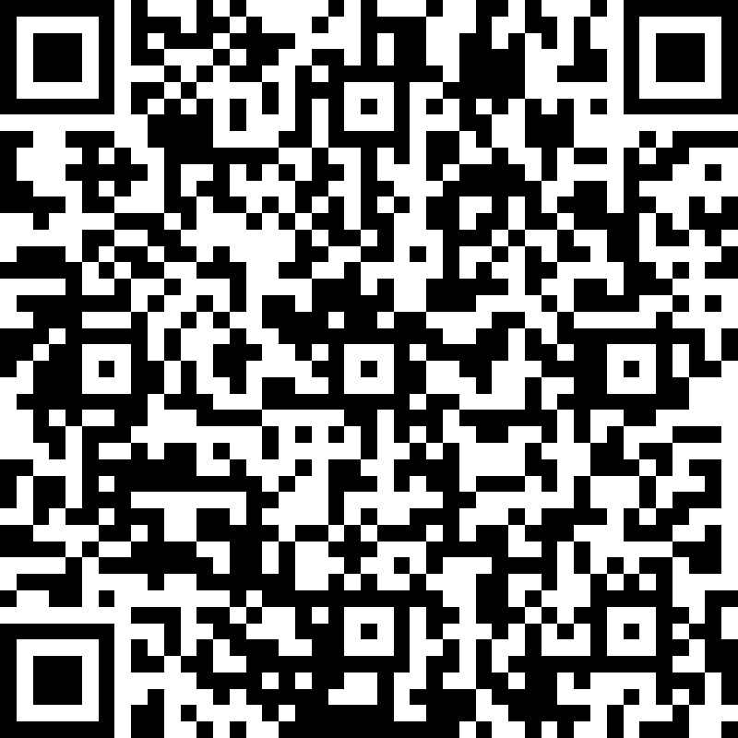
Session Feedback Day 1 (not optional!)
http://bit.ly/DataGrillen2019Day1

Slide 14
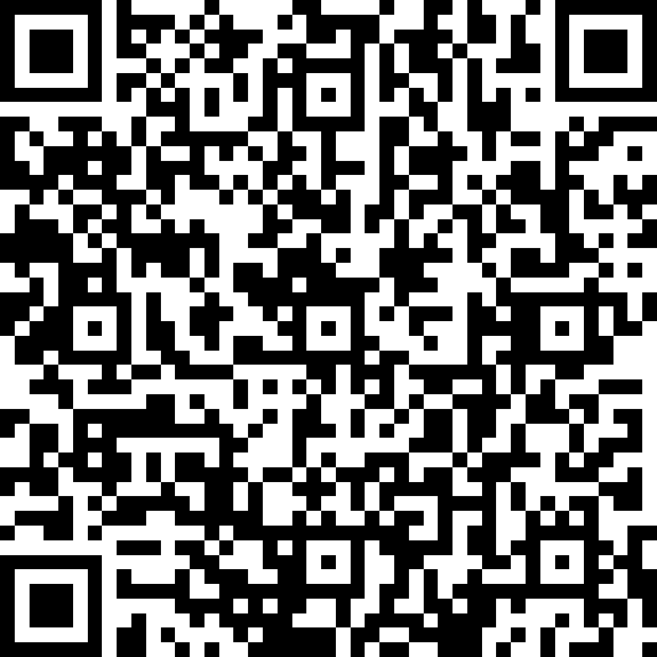
Event Feedback (not optional!)
http://bit.ly/DataGrillen2019Event

